Slide 1
Final Project JCDS Mushroom Web App
Andrew Edbert

Slide 2
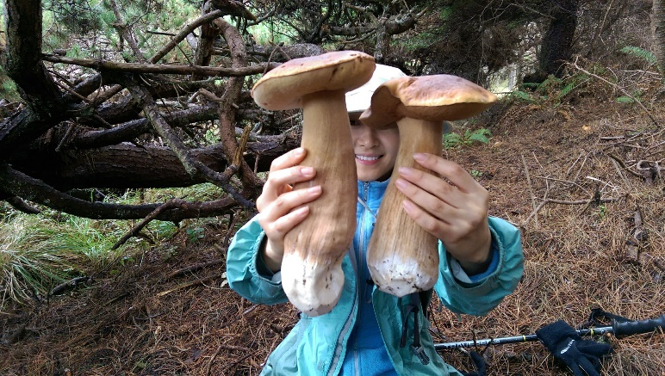
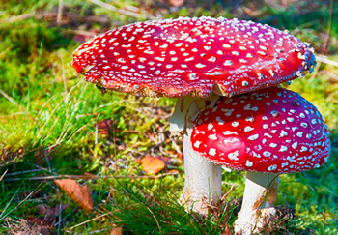
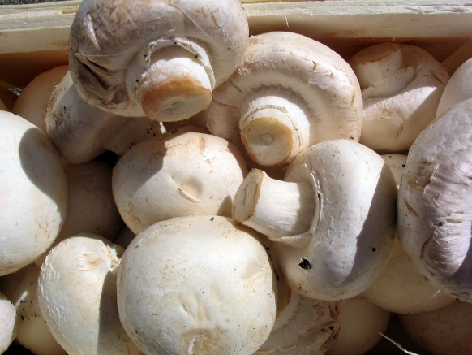
Background
Popularity of mushroom hunting
Confusion between poisonous and edible (non-poisonous) mushroom

Slide 3
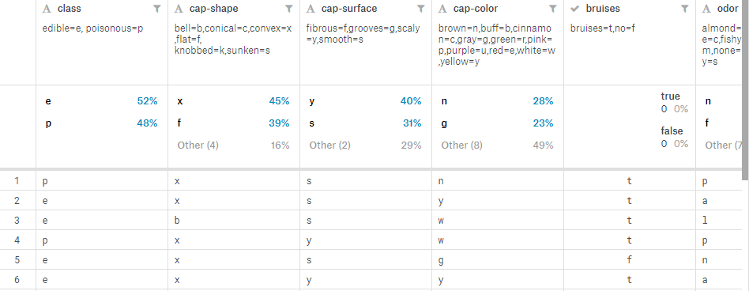
Dataset
The dataset is from Kaggle, with original components can be seen at UCI Machine Learning sites.
Features are classified with alphabetical signs, with translation available.

Slide 4
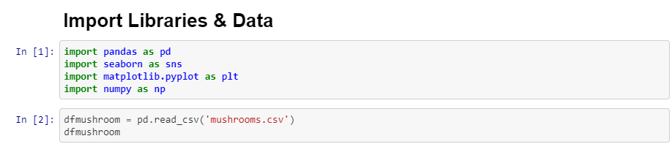
Importing Dataset

Slide 5
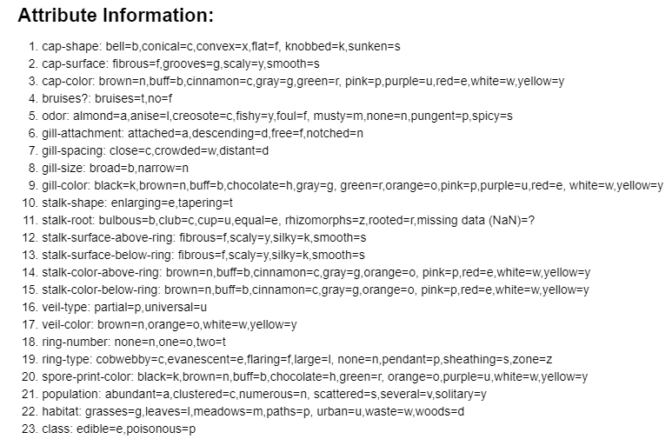
Translating Alphabetical Value

Slide 6
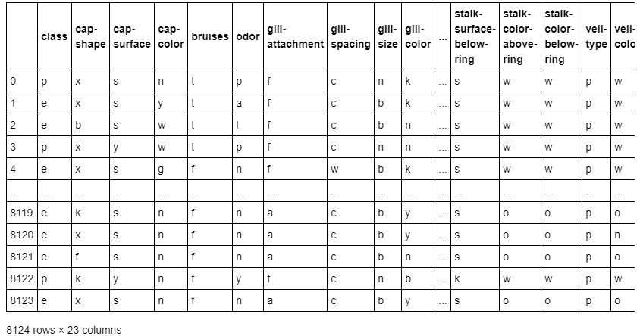
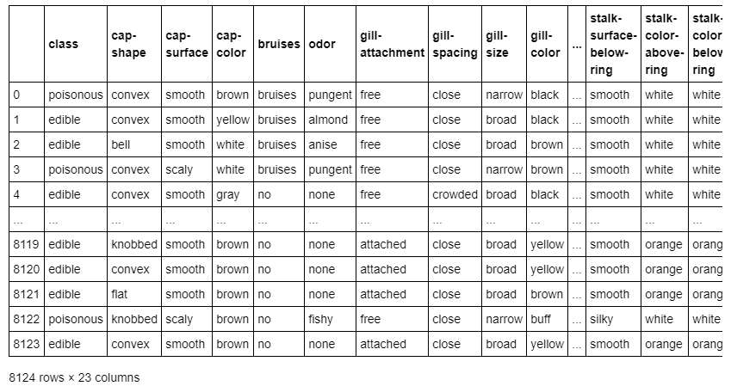
Translating Alphabetical Value

Slide 7
Exploratory Data Analysis
Visualize and Analyze mushrooms data frame
Repairing missing / damage features if possible
Deciding which columns / features to be dropped

Slide 8
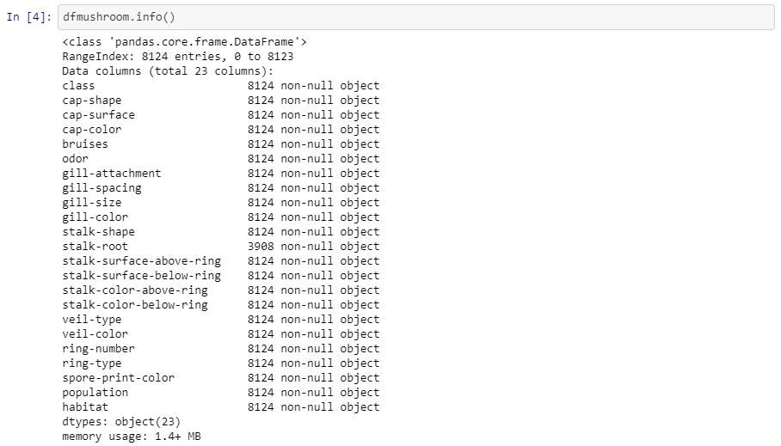
Exploratory Data Analysis
Mushrooms dataset is categorical and all data values are string object

Slide 9
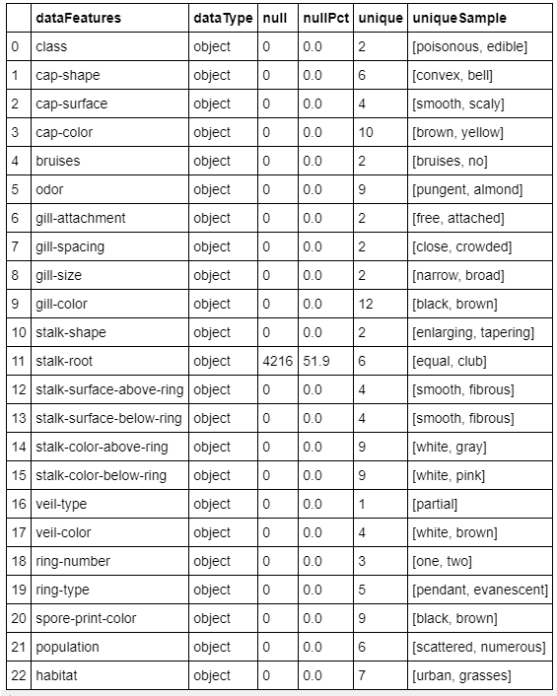
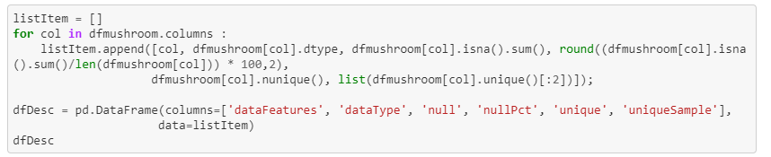
Exploratory Data Analysis

Slide 10
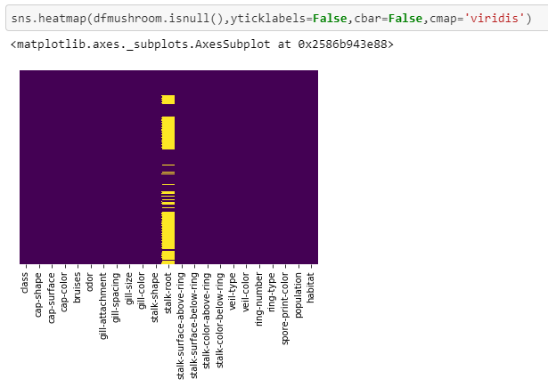
Exploratory Data Analysis
‘stalk-root’ has a lot of missing values

Slide 11
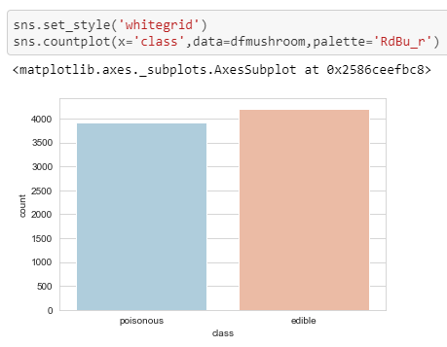
Exploratory Data Analysis
The target feature (‘class’) relatively balanced

Slide 12
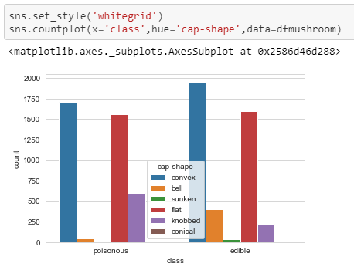
Exploratory Data Analysis

Slide 13
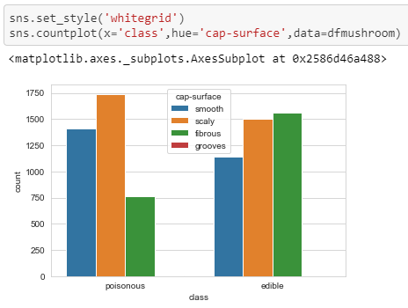
Exploratory Data Analysis

Slide 14
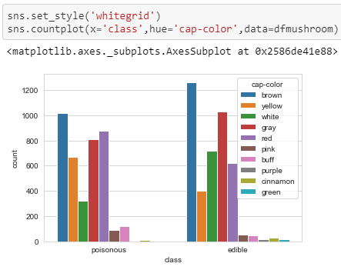
Exploratory Data Analysis

Slide 15
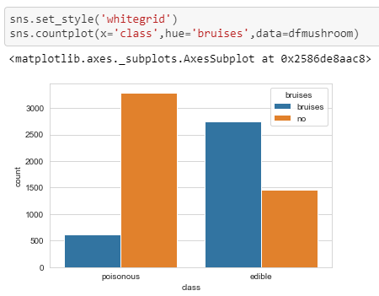
Exploratory Data Analysis

Slide 16
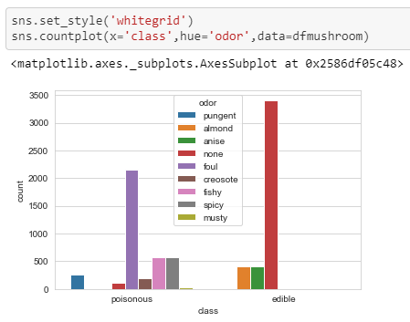
Exploratory Data Analysis

Slide 17
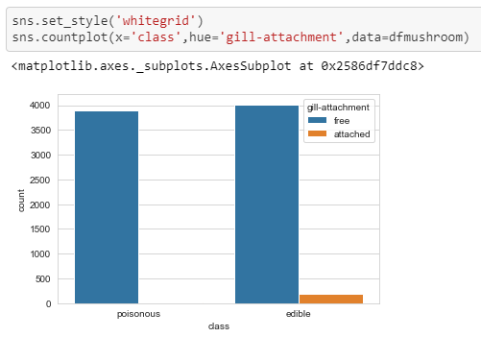
Exploratory Data Analysis

Slide 18
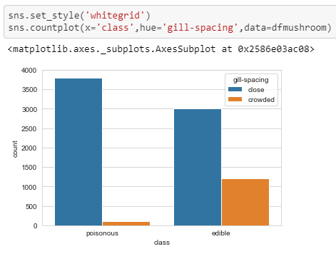
Exploratory Data Analysis

Slide 19
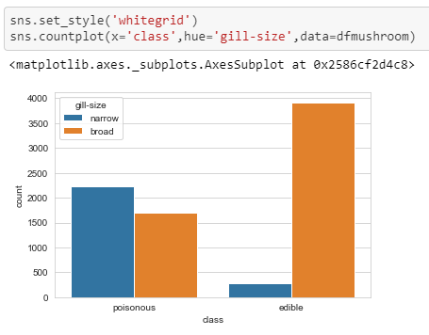
Exploratory Data Analysis

Slide 20
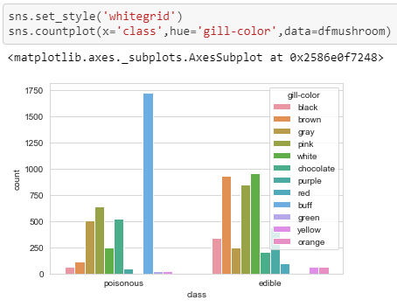
Exploratory Data Analysis

Slide 21
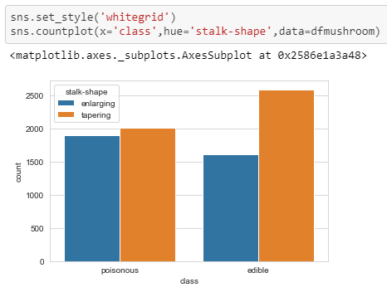
Exploratory Data Analysis

Slide 22
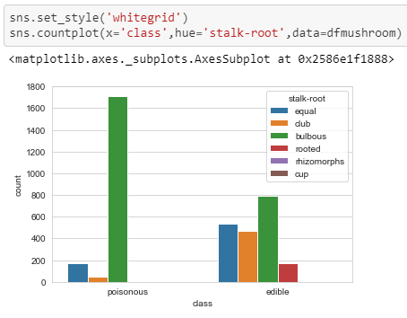
Exploratory Data Analysis

Slide 23
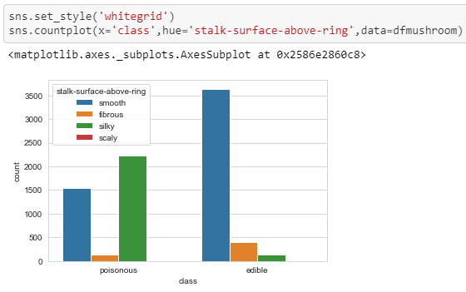
Exploratory Data Analysis

Slide 24
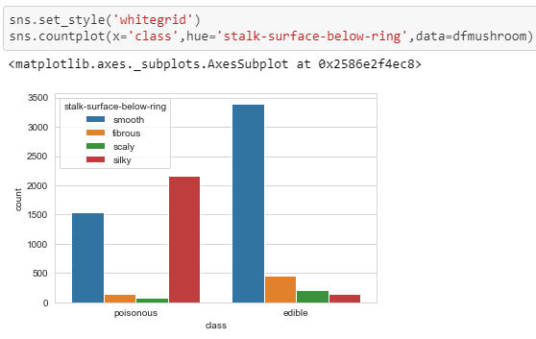
Exploratory Data Analysis

Slide 25
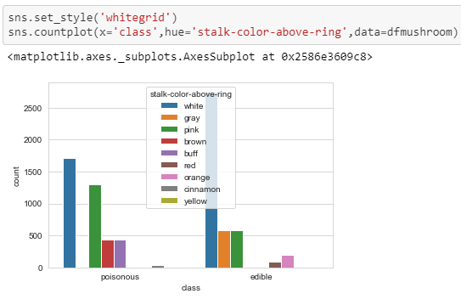
Exploratory Data Analysis

Slide 26
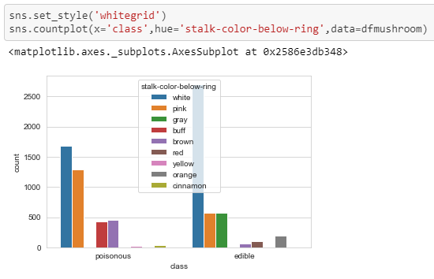
Exploratory Data Analysis

Slide 27
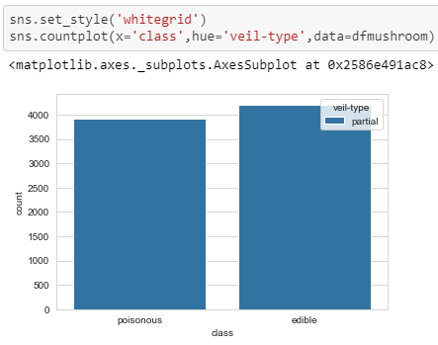
Exploratory Data Analysis

Slide 28
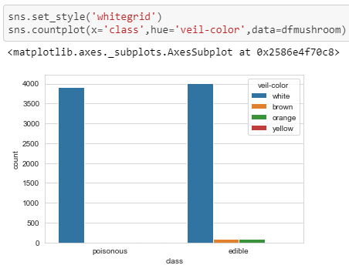
Exploratory Data Analysis

Slide 29
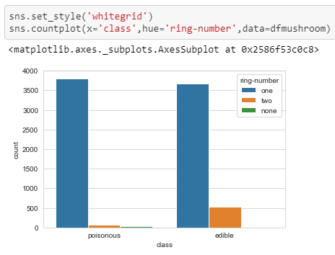
Exploratory Data Analysis

Slide 30
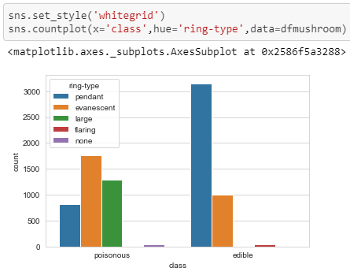
Exploratory Data Analysis

Slide 31
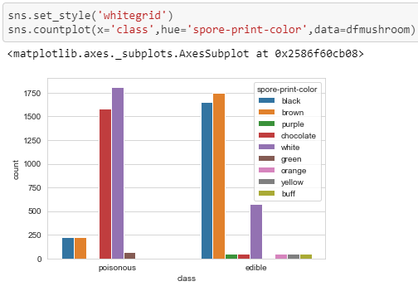
Exploratory Data Analysis

Slide 32
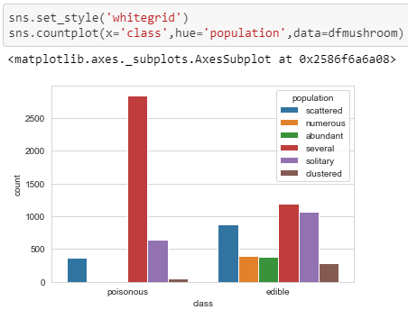
Exploratory Data Analysis

Slide 33
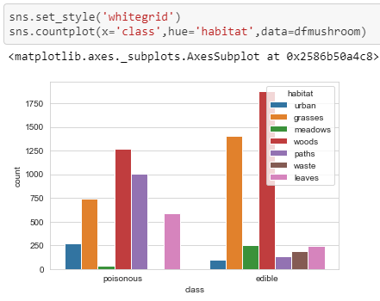
Exploratory Data Analysis

Slide 34
Exploratory Data Analysis
Based on visualization and analysis, it was decided to drop ‘stalk-root’ and ‘veil-type’
‘veil-type’ only have one unique value, thus make it non-heterogenous feature

Slide 35
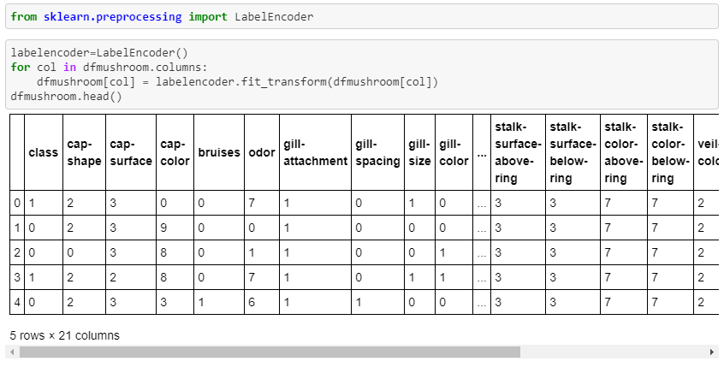
Label Encoding

Slide 36
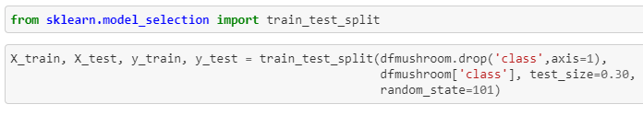
Train Test Split
30 % test size were chosen
random_state=101 to ensure relatively balanced target

Slide 37
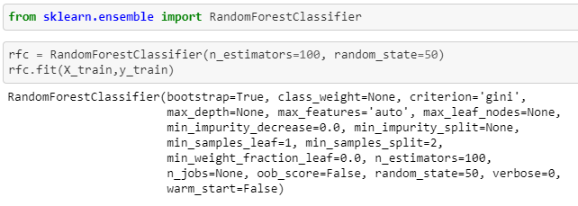
Train The Model
Importing Random Forest Classifier library

Slide 38
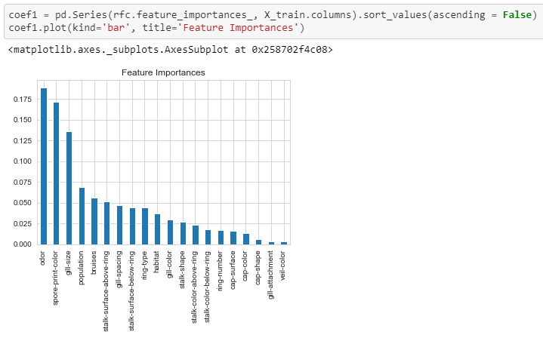
Feature Importance
Plotting features importance value in descending order

Slide 39
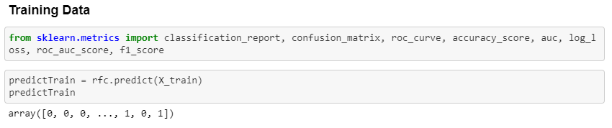
Model Evaluation

Slide 40
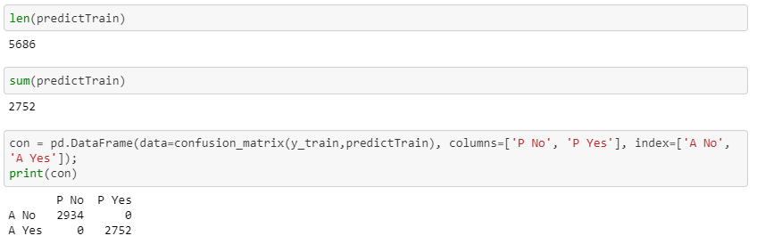
Model Evaluation

Slide 41
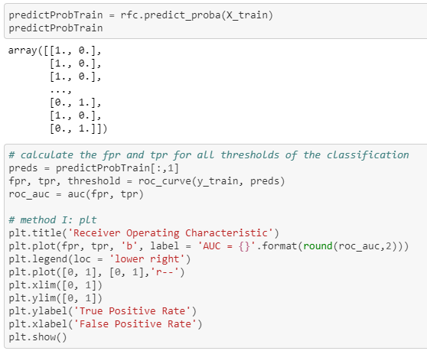
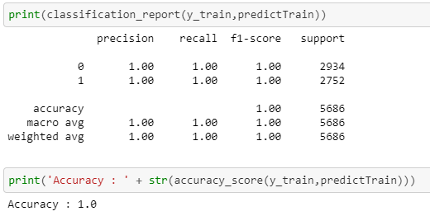
Model Evaluation

Slide 42
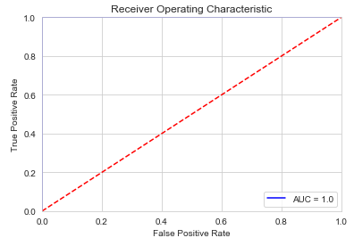
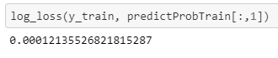
Model Evaluation

Slide 43
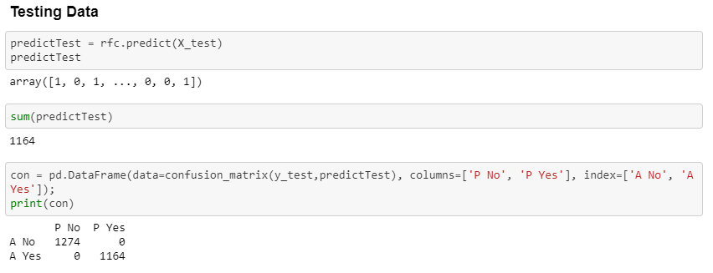
Model Evaluation

Slide 44
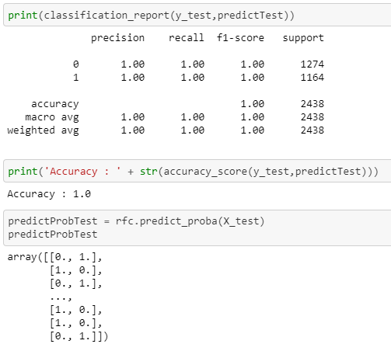
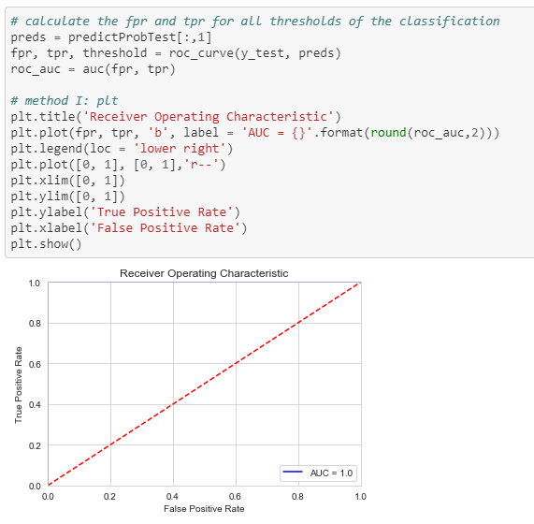
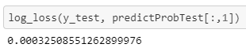
Model Evaluation

Slide 45
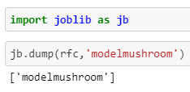
Dumping Model Into Joblib File
Joblib File will be called in flask app python file
The flask will contain input and output parts, with joblib model file bridging them

Slide 46




Flask App

Slide 47
Flask App
Consists of Login / Logout, Main Page, Test History, About Mushrooms
Uses Bootstrap templates
User database in json file
Main page = prediction page
Test history consists of prediction results and its indicator tested for each user
About mushrooms section used for general knowledge of mushrooms with sources from websites

Slide 48

Flask App
Username and Password are stored in json file named database.json
Whenever a user wants to login, the app will check both username and password in this json file
If a username does not exist, then the user will have to sign up
When signing up, if the username already exists, then the notification will pop up

Slide 49


Flask App

Slide 50

Flask App
Navbar used to select other menu

Slide 51
Flask App
Main Page is a section where user will be able to input some indicators for prediction

Slide 52

Flask App
Test History section is to record user testing activities
Testing history are stored in MySQL database

Slide 53

Flask App
Info about mushrooms in general can be found in About Mushroom section

Slide 54

End of Slides

